Slide 1

PREDICTING CUSTOMER BUYING BEHAVIOUR
JITHIN MOHAMMED KHAN
27/06/2023

Slide 2
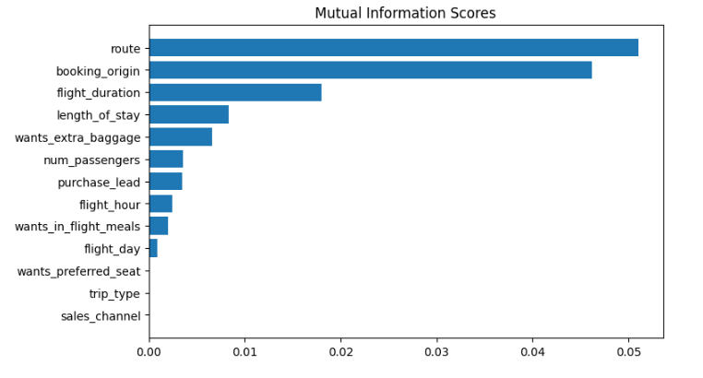
PREDICTIVE MODEL TO UNDERSTAND FACTORS THAT INFLUENCE BUYING BEHAVIOUR
We have trained the data set with Random forest classifier model and received
ACCURACY: 85.09
AUC score: 0.558
route
booking_origin
flight_duration
wants_extra_baggage
length_of_stay
are the top 5 features which influence
Customer buying behavior
The AUC score must be improved.

